Slide 1
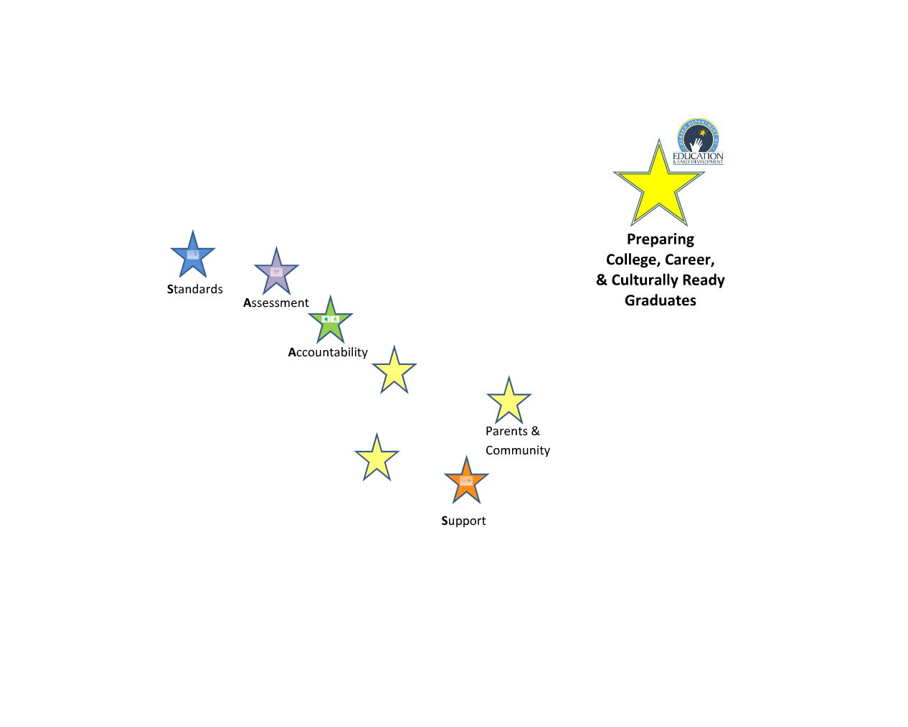
Notes:
As you know there is a lot of change happening in Alaskan education. The focus for this change is for us to continue to improve with what matters most – preparing student effectively for their lives after they graduate. In helping people to make sense of all of this change, we want to keep the focus on Preparing College, Career, and Culturally Ready Graduates – preparing students to successful enter college, for the work place and careers, and to participate fully as members of their culture and communities. The system of Alaskan education by which we work to do this is through a system of standards, assessment, accountability, support for districts and schools, and of engaging parents and the community. I am going to briefly walk you through each of these areas.

Slide 2
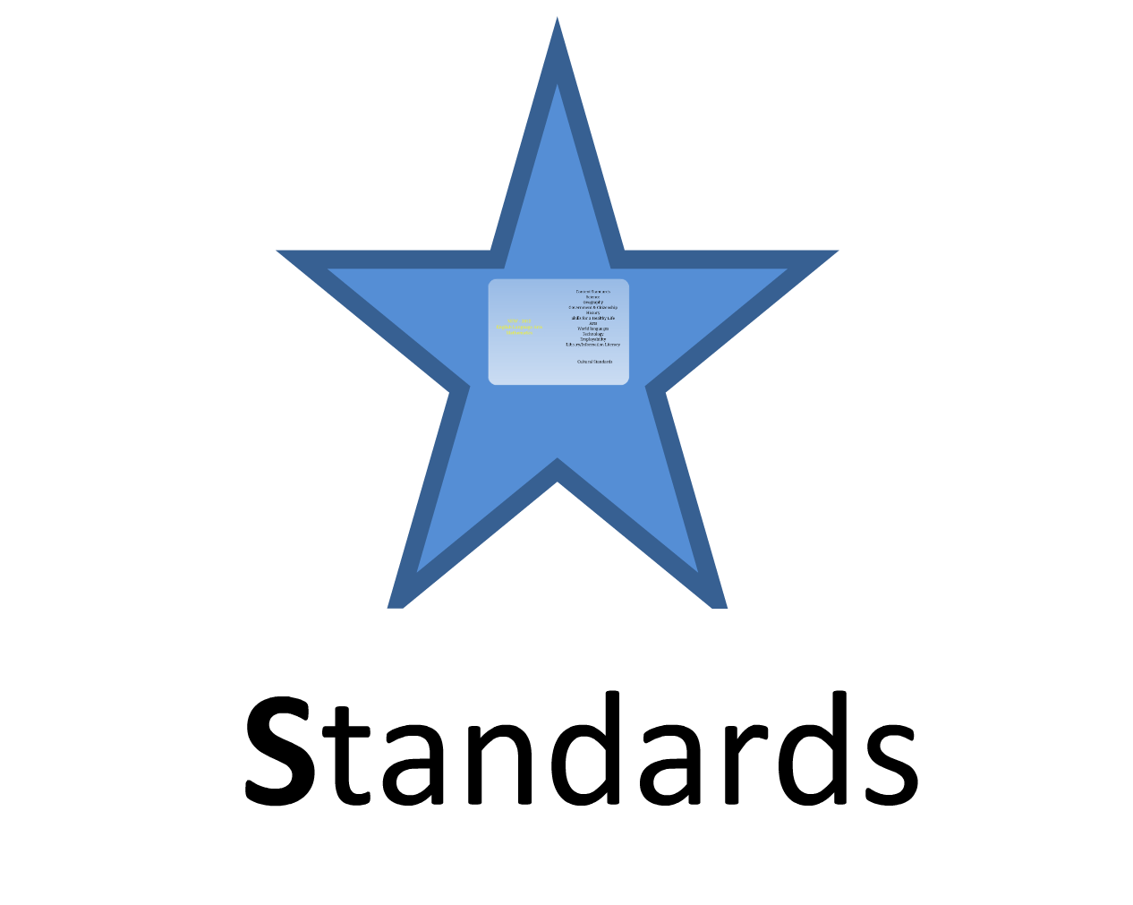
Notes:
The first area is standards…

Slide 3
Notes:
In 2012, we adopted new English Language Arts and Math Standards. As you know, we did not adopt the Common Core State Standards, but we did adopt standards that are more rigorous that our GLEs were because they are aimed at effectively preparing students to enter college and the workplace. We also continue to have content standards for science, geography, government, and all of the other areas listed. We also have the Standards for Culturally Responsive Schools which we frequently refer to as the Cultural Standards. There are specific cultural standards for students that are adopted standards in the state of Alaska.

Slide 4
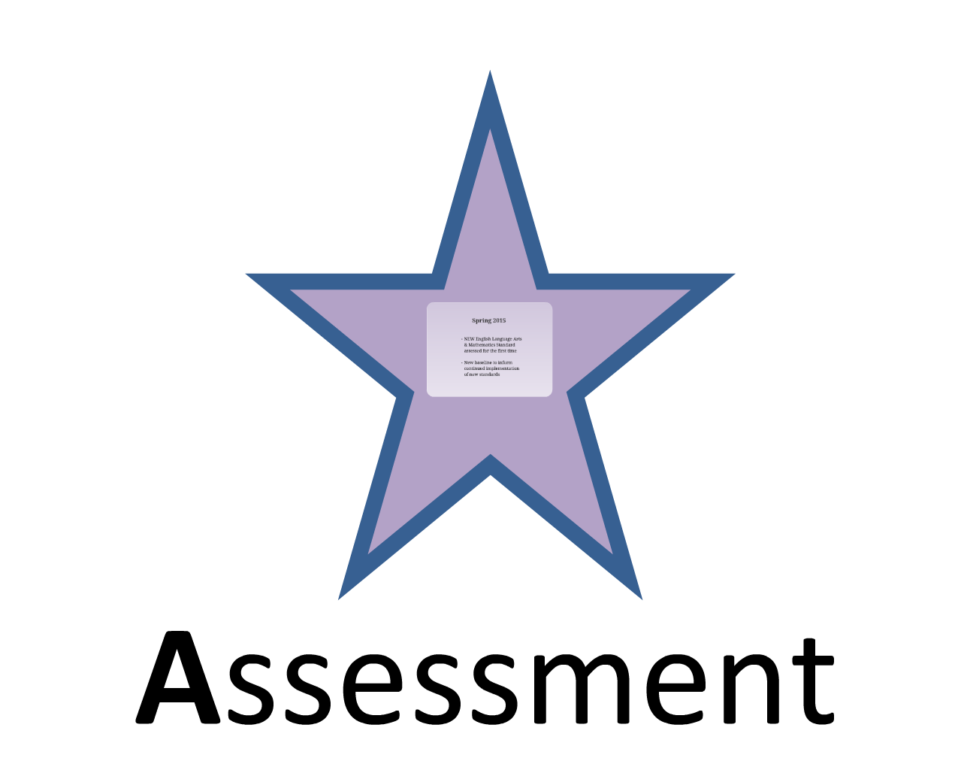
Notes:
The next area is Assessment

Slide 5
Notes:
Currently, we are continuing to assess Alaska’s students each year using the Standards Based Assessments based on our previous GLEs. However, in the Spring of 2015 we will assess how students are doing on our new English and Math Standards for the first time. Because these are more rigorous standards, it is possible that we may have a dip in terms of student achievement across the State. Want we want to do now is to thoughtfully and intentionally begin to move our instruction to those new standards knowing that in 2015 we will have a new baseline of student achievement across the State and that we can then use that information to inform improvement efforts.

Slide 6
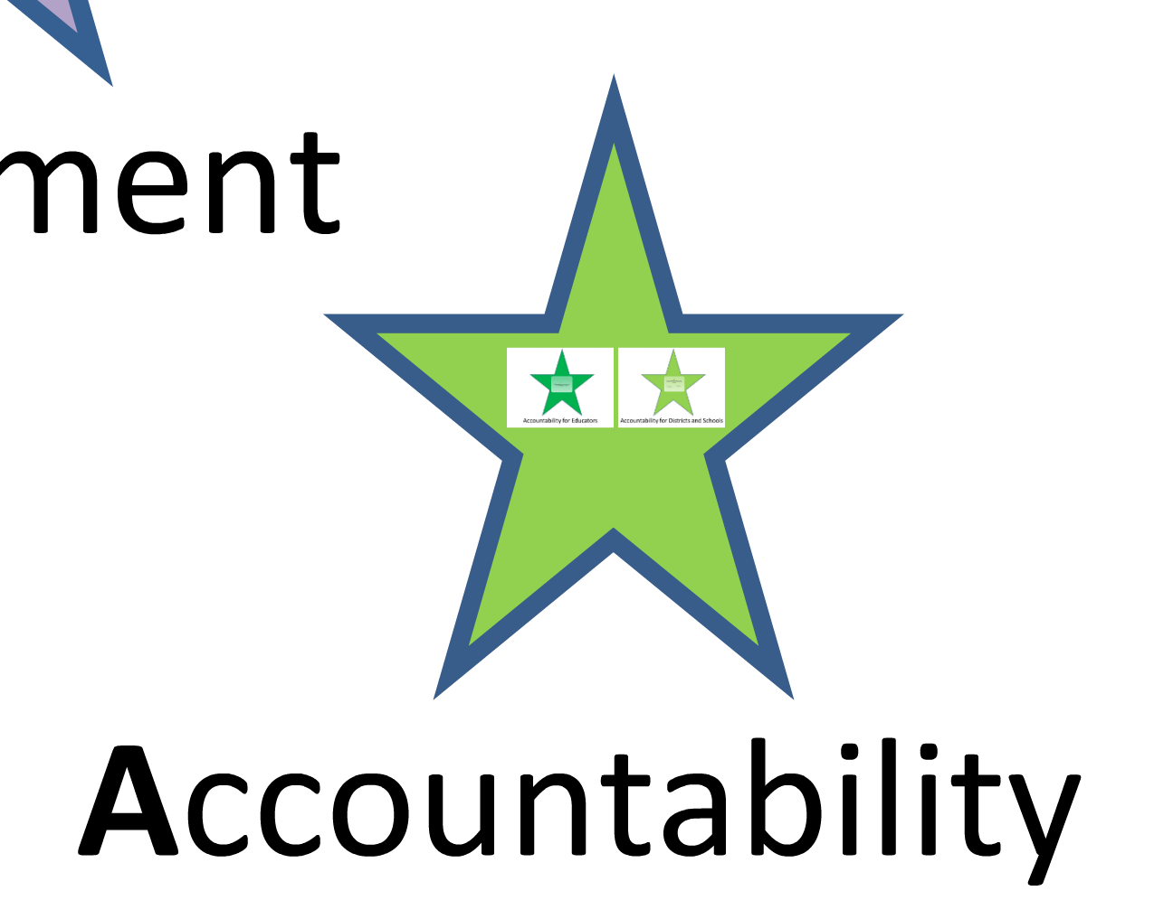
Notes:
The next area is Accountability

Slide 7
Notes:
And within this area there are two new accountability systems: Accountability for Educators and Accountability for Districts and Schools.

Slide 8
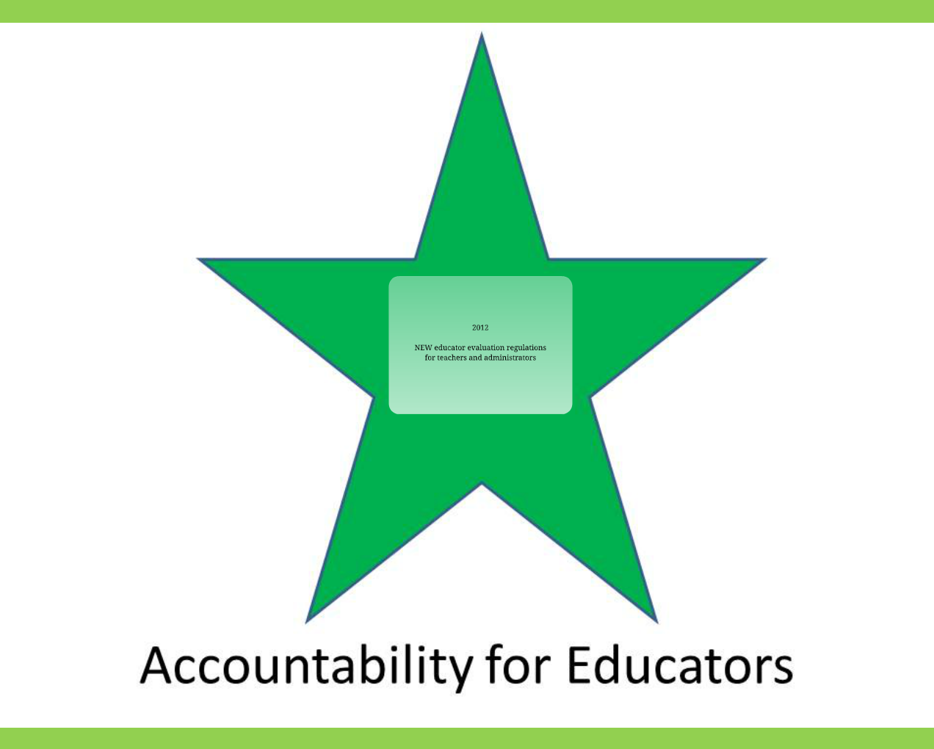
Notes:
First, we are going to talk about Accountability for Educators.

Slide 9
Notes:
In December of 2012, the State Board of Education adopted new regulations outlining evaluation requirements for teachers and administrators. These requirements will consider student achievement data toward an educator’s evaluation and that will occur for the first time in 2016 when 20% of an educator’s evaluation will be informed by growth in student achievement. For another year, the percent will stay at 20%. In 2017-2018 that percentage increases to 35%. And then in 2018-2019 and from then on 50% of an educator’s evaluation will be informed by students learning data.

Slide 10
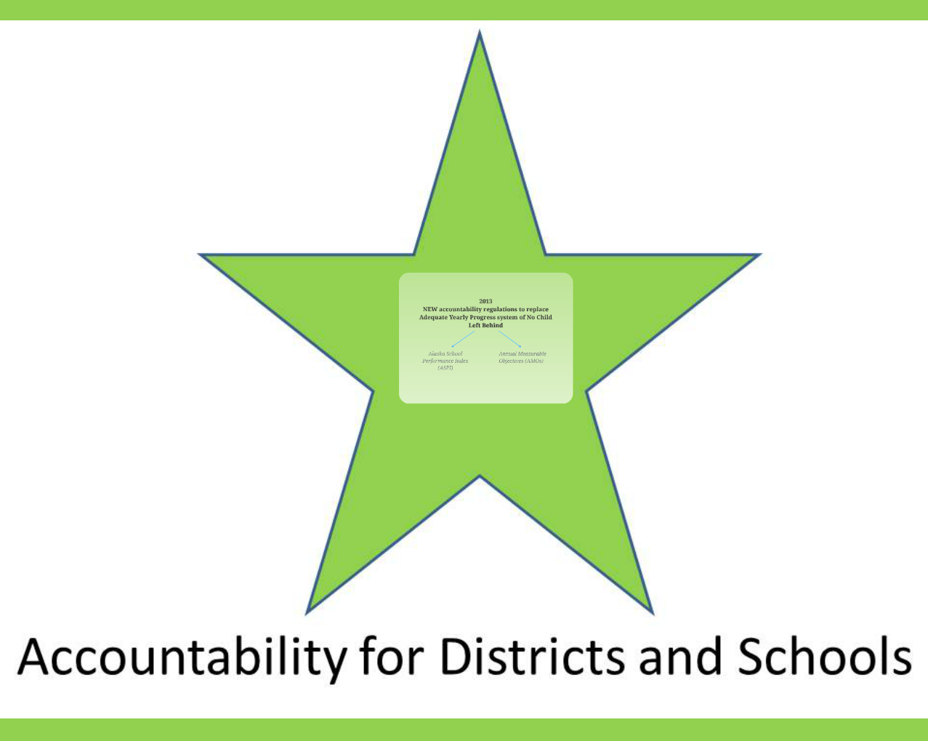
Notes:
Next we are going to talk about Accountability for Districts and Schools.

Slide 11
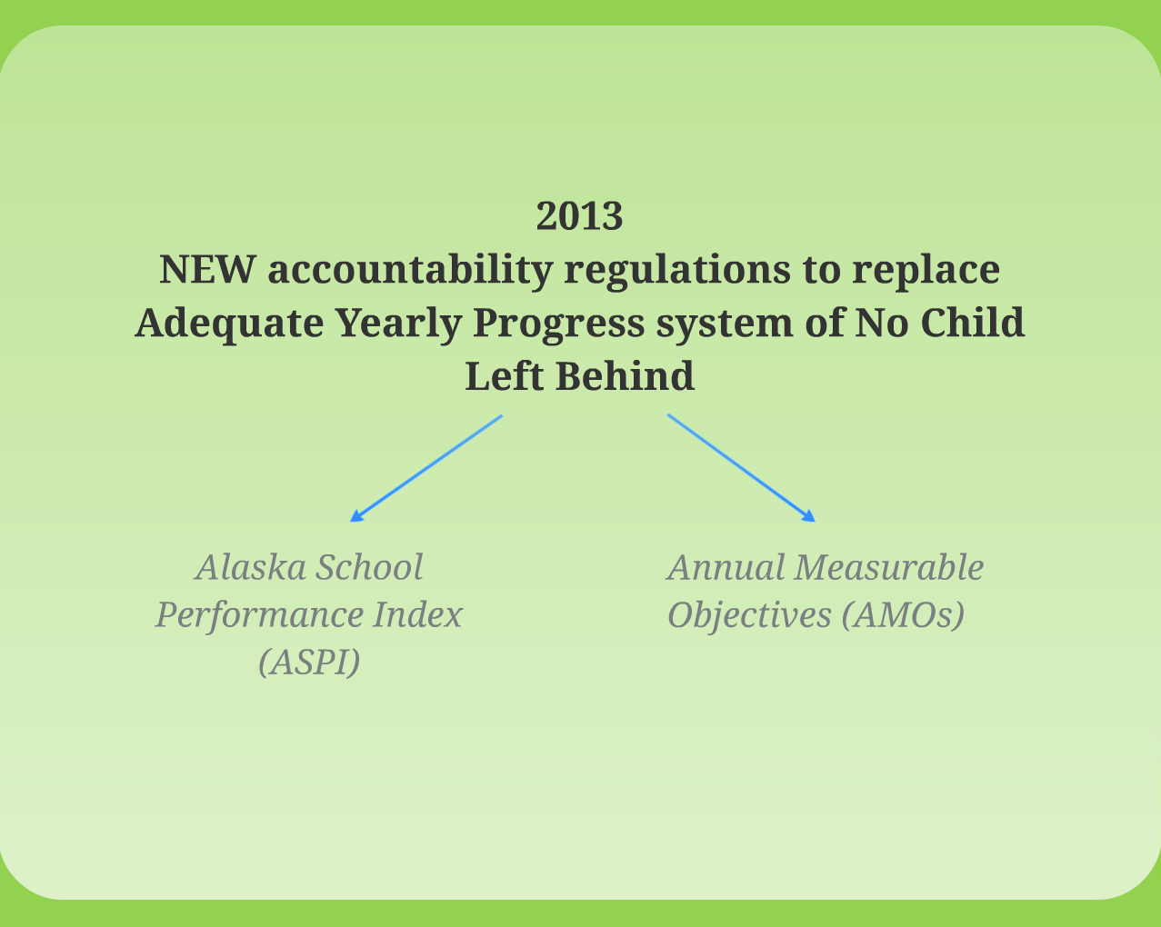
Notes:
Because our ESEA Waiver was approved by the US Department of Education, Alaska was able to design a new accountability system to replace Adequate Yearly Progress. Our new system has two main components: the Alaska School Performance Index (ASPI) and new Annual Measurable Objective Targets (AMOs). The ASPI rating assigns schools a star rating of 1 – 5 stars. While it does still consider the % of students who are proficient, it also acknowledges student growth as 40% of the index. This is very different than the one-size-fits-all structure of AYP. Instead of valuing student growth only if it moves to proficient or above, it acknowledges student growth using 7 different levels of student achievement. The other part of the School Accountability system are new AMO targets that are unique for each school. Starting with a baseline in 2012, each school’s target are based on reducing by half the % of non-proficient students over a 6-year period. For example, if in 2012 24% of students weren’t proficient, the target would be that 6 years later, only 12% of the students aren’t proficient. The targets each year, then, are a 2% reduction in the number of students who aren’t proficient. This is very different than the statewide AMO targets that were applied to every school under AYP. Had we not received our waiver, the AMOs for 2013 were 94% proficient in reading and 91% proficient in math. Only 20 schools would have met those targets outright (without applying confidence intervals of safe harbor). The new system recognizes and values growth in student achievement, not just whether or not a student is proficient.

Slide 12
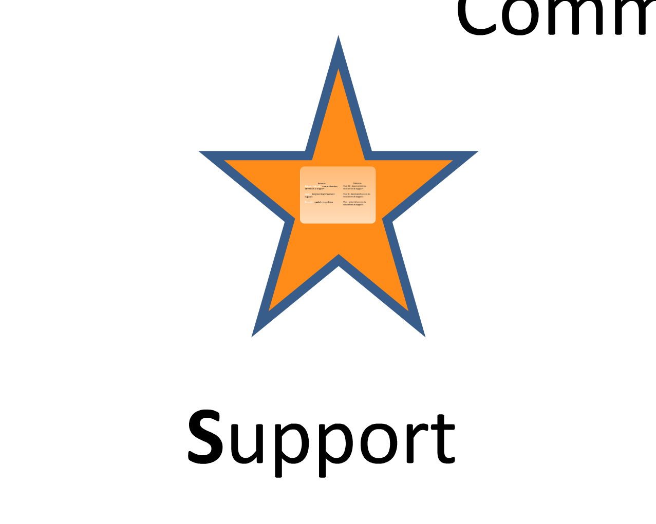
Notes:
The next area is support

Slide 13
Notes:
Both the ASPI score and AMO targets inform our support and recognition for schools. We are required to identify the lowest performing 5% of Title I schools as Priority Schools and the next lowest performing 10% of Title I schools as Focus Schools. The department works with these schools to provide them with support toward school improvement planning and implementation. The top 10% of schools in Alaska in terms of percent of students who are proficient are recognized as Reward Schools. Additionally, the top 10% in terms of students growth are also recognized as Reward Schools. We are hoping to announce Reward Schools on August 15th. Finally, all districts in Alaska are identified as Tier 1, Tier 2, or Tier 3 Districts. Tier 1 districts are those that have 25% or fewer of their schools as 1- and 2- star schools. Tier II are districts with between 25% and 50% of their schools as 1- and 2- star schools. And, Tier III districts are those with 50% of more of their schools as 1- and 2- star, or 50% or more of their students in 1- and 2- star schools. Again, the district works with Tier II districts most intensely to provide needed support.

Slide 14
Notes:
So this brings us back to the College, Career, and Culturally Ready Graduates logo. This logo will be the primary way through which educators, parents, and the community access resources to help them understand all of the changes happening in education in Alaska. This logo will be on the department’s front page of the website and it will be updated regularly with useful resources and timely information.

Slide 15
Notes:
What is most important is that all of this change is to work together to get better at this – preparing students for successful lives after they leave us. Yes, it does mean quite a bit is changing, but our students are worth our continued improvement efforts so that they are able to be successful in college, careers, and as members of their culture and communities.

