Slide 1
Alaska Mathematics Standards Overview
Notes:
Welcome to an overview of Alaska Mathematics Standards Organization

Slide 2
Shifts in Mathematics
Focus: 2-3 topics focused on deeply in each grade.
Coherence: Concepts logically connected from one grade to the next and linked to other major topics within the grade.
Rigor: Fluency with arithmetic, application of knowledge to real-world situations, and deep understanding of mathematical concepts.
Notes:
In the mathematics standards, there are three shifts which will encourage changes to instructional practices and curriculum.
Focus: 2-3 topics focused on deeply in each grade. For each grade level there are fewer big ideas to be covered.
Coherence: : Concepts logically connected from one grade to the next and linked to other major topics within the grade. There is a progression of topics allowing for deeper learning each year. This also avoids the re-teaching of topics each year.
Rigor: Fluency with arithmetic, application of knowledge to real-world situations, and deep understanding of mathematical concepts. The standards explicitly start with the goal of career and college readiness and backtrack to develop a body of knowledge to support this goal.

Slide 3
K-8 Standards for Mathematical Content
Grade Span
Instructional Focus
Standards for Mathematical Content
Grade Level
Domains
Clusters
Standards
Domains
Counting, Cardinality and Ordinality
Operations and Algebraic Thinking
Number and Operations in Base Ten
Measurement and Data
Number and Operations – Fractions
Geometry
Ratios and Proportional Relationships
The Number System
Expressions and Equations
Functions
Statistics and Probability
3
Notes:
This slide is to provide an orientation to the Standards for Mathematical Content for grades K-8. The content standards are organized by grade spans (K-2, 3-5, and 6-8) similar to the GLEs. For each grade span, there is an instructional focus followed by the content standards. These content standards are provided for each grade level and are further broken down into domain, clusters and standards which we will be examining more closely. The domains are outlined on the right and correspond most closely to the strands that were found in the GLEs.

Slide 4
Shift #1 Focus – Critical Areas
Instructional Focus: Kindergarten through Second Grade
4
Notes:
There are typically two to four Critical Areas for instruction for each grade level. The NCTM Focal Points were used as a model for the creation of the critical areas.
They bring focus to the standards at each grade by grouping and summarizing the big ideas that educators can use to build their curriculum and to guide instruction.
Let’s examine the critical areas of focus for Kindergarten of the math Standards.

Slide 5
Kindergarten Instructional Focus
Instructional time should focus on two critical areas:
(1) representing, relating, and operating on whole numbers, initially with sets of objects;
(2) describing shapes and space.
More learning time in Kindergarten should be devoted to number than to other topics.
5
Notes:
In Kindergarten, there are two critical areas of instructional focus:
representing, relating and operating on whole numbers, initially with sets of objects;
Describing shapes and space.
Number - learning how numbers correspond to quantities, and learning how to put together (compose) and take them apart (decompose) numbers.

Slide 6
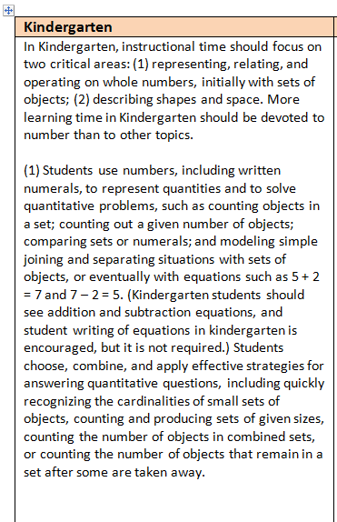
Examining a critical area further
For each critical area for K-8 there is an further explanation and often examples to clarify.
6
Notes:
For each K-8 grade level there is further explanation of each of the critical focus area.
Shown here is the further explanation for the first critical area in Kindergarten.

Slide 7
Critical Areas by Grade Levels
Grade
K–2 | Addition and subtraction, measurement using whole number quantities
3–5 | Multiplication and division of whole numbers and fractions
6 | Ratios and proportional reasoning; early expressions and equations
7 | Ratios and proportional reasoning; arithmetic of rational numbers
8 | Linear algebra
7
Notes:
Here is an overview of the critical areas in K-8 mathematics. These are intended to establish a firm foundation for high school algebra.
The Alaska Mathematics Standards approach mathematics in a different way – encouraging diving deep into a critical area.

Slide 8
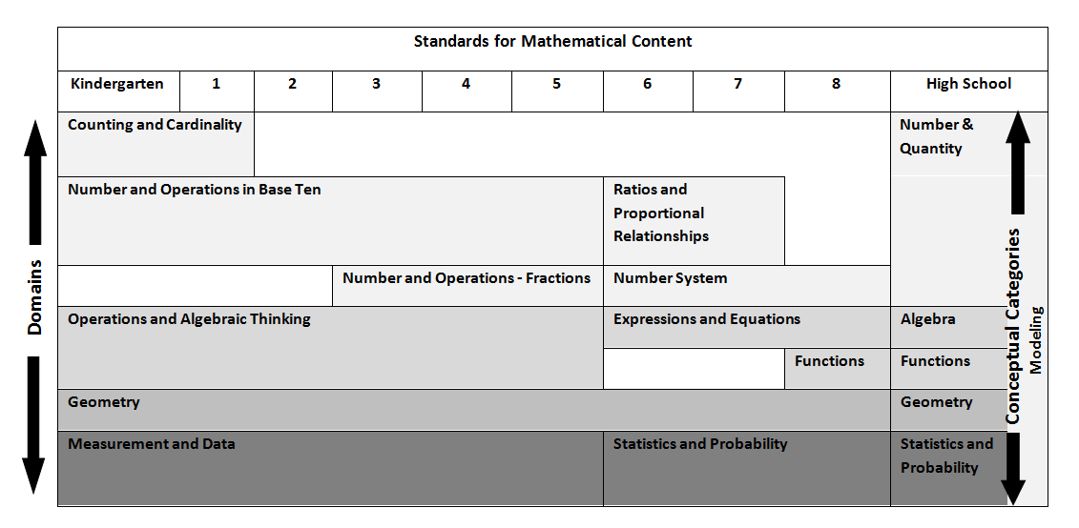
Shift #2 Coherence - Domains
Domains – large groups of related standards.
They may begin and end in different grades.
8
Notes:
The standards provide coherence through the use of domains, large groups of related standards, that make explicit the connections of standards within and across grade levels.
Topics have clear beginning and ending points as indicated in this chart. Notice counting, cardinality and ordinality is a domain for grades K-1 only. Whereas Number and Operation in Base Ten continues through K-5. The study of fractions doesn’t begin until Grade 3. Some domains such as Statistics and Probability continue the exploration in earlier grades.
Some may recognize that this is quite similar to the topic placement in other top achieving countries. in contrast to what has typically been found in the U.S. in the past, where the same strands were addressed in every grade K-12 (similar to the Alaska GLEs where six content strands repeated for grades K-10).

Slide 9
Coherence - Clusters
Clusters – groups of closely related standards inside domains, subsets of domains.
Let’s look at the grades 3-5 clusters.
9
Notes:
It is important to also explore the cluster headings to see how a domain such as: Operations and Algebraic Thinking more specifically progresses through grades K – 5.
Clusters (indicated in bold) further group even more closely related standards under domains.
On the next few slides, we will look at the clusters for grades 3-5 by their domains which they provide a good overview of topics for this grade span.

Slide 10
Operations and Algebraic Thinking (OA)
Grade 3 | Grade 4 | Grade 5
• Represent and solve problems involving multiplication and division. • Understand properties of multiplication and the relationship between multiplication and division. • Multiply and divide up to 100. • Solve problems involving the four operations, and identify and explain patterns in arithmetic. | • Use the four operations with whole numbers to solve problems. • Gain familiarity with factors and multiples. • Generate and analyze patterns. | • Write and interpret numerical expressions. • Analyze patterns and relationships.
10
Notes:
The clusters show the progression of the topics within this grade span under the domain of Operations and Algebraic Thinking.
Please take a moment to review these cluster headings noticing the connections between them.

Slide 11
Number and Operations in Base Ten (NBT)
Grade 3 | Grade 4 | Grade 5
• Use place value understanding and properties of operations to perform multi-digit arithmetic. | • Generalize place value understanding for multi-digit whole numbers. • Use place value understanding and properties of operations to perform multi-digit arithmetic. | • Understand the place value system. • Perform operations with multi-digit whole numbers and with decimals to hundredths.
11
Notes:
There are only a few clusters under the Number and Operations in Base Ten in this grade span. Please note there was not an equivalent focus in the GLEs.

Slide 12
Number and Operations—Fractions (NF)
Grade 3 | Grade 4 | Grade 5
• Develop understanding of fractions as numbers. | • Extend understanding of fraction equivalence and ordering. • Build fractions from unit fractions by applying and extending previous understandings of operations on whole numbers. • Understand decimal notation for fractions, and compare decimal fractions. | • Use equivalent fractions as a strategy to add and subtract fractions. • Apply and extend previous understandings of multiplication and division to multiply and divide fractions.
12
Notes:
The domain of Number and Operations begins in Grade 3. By looking at the clusters, you can see the additional clusters during Grade 4 and 5.

Slide 13
Measurement and Data (MD)
Grade 3 | Grade 4 | Grade 5
• Solve problems involving measurement and estimation of intervals of time, liquid volumes, and masses of objects. • Represent and interpret data. • Geometric measurement: understand concepts of area and relate area to multiplication and to addition. recognize perimeter as an attribute of plane figures and distinguish between linear and area measures. | • Solve problems involving measurement and conversion of measurements from a larger unit to a smaller unit. • Represent and interpret data. • Geometric measurement: understand concepts of angle and measure angles. | • Convert like measurement units within a given measurement system. • Represent and interpret data. • Geometric measurement: understand concepts of volume and relate volume to multiplication and to addition.
13
Notes:
The domain of Measurement and Data shows through the clusters learning at one grade level is linked to the next grade.
Notice the similar cluster heading, Represent and interpret data, is found at each grade level with different grade level standards.

Slide 14
Geometry (G)
Grade 3 | Grade 4 | Grade 5
• Reason with shapes and their attributes. | • Draw and identify lines and angles, and classify shapes by properties of their lines and angles. | • Graph points on the coordinate plane to solve real-world and mathematical problems. • Classify two-dimensional figures into categories based on their properties.
14
Notes:
The Geometry domain is one of the few that span K-8 and into high school. The clusters help show the progression of this topic in this grade span.

Slide 15
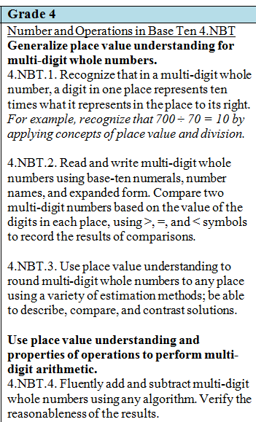
Examining a cluster
Clusters
Generalize place value understanding for multi-digit whole numbers.
Use place value understanding and properties of operations to preform multi-digit arithmetic.
The standards grouped under the clusters are even more closely related.
15
Notes:
In this Grade 4 example under the domain, Number and Operations in Base Ten (4.NBT) which is underline.
There are two clusters shown in bold type – Generalize place value understanding . . . and Use place value understanding and properties of operations . . .
For each cluster, there are a list of closely related standards underneath. For the first cluster, Generalize, there are three grade level standards.
Only the first standard for the second cluster is shown in this snapshot.

Slide 16
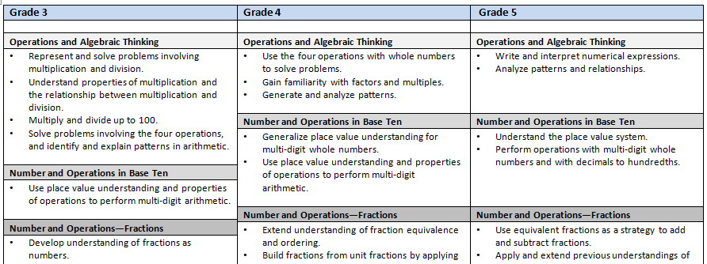
Mathematical Content Standards Overview
Provides the domains and clusters by each of the grade span
16
Notes:
The slide shows a companion document, Mathematical Content Standards Overview, available on the EED website.
This document provides a good overview of the content by providing only the domains and clusters by each grade span.

Slide 17
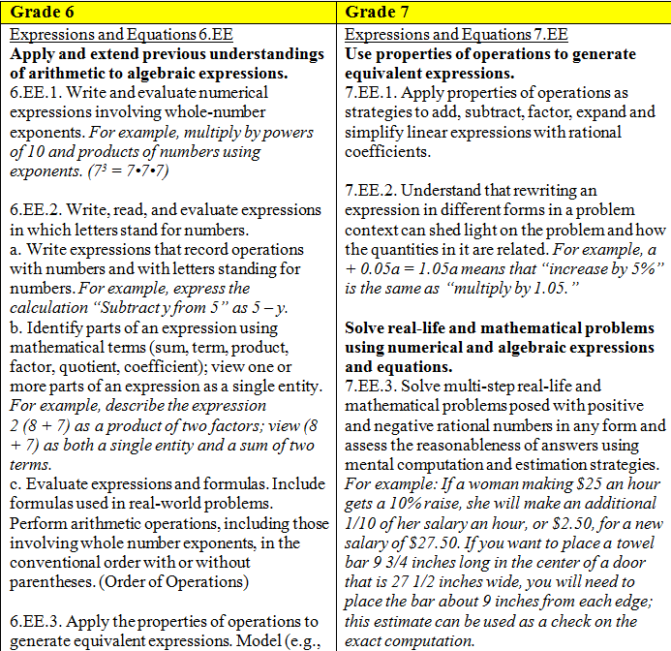
Closer Look at Standards (6-8)
Domain
Clusters
17
Notes:
Taking a close look at these sample standards from the grade span 6-8.
The domain is Expressions and Equations (EE) which is underlined.
For 7th grade there are two clusters – Use properties of operations to generate equivalent expressions and Solve real-life and mathematical problems. . .
Underneath the clusters are the standards.

Slide 18
Closer Look at Standards (6-8)
Example
Subparts
18
Notes:
Now, taking even a closer look at these sample standards in grade span 6-8.
Under Grade 6, there are two further features (examples and subparts)
Let’s look at 6.EE.1. Notice in italics there is an example provided for further clarification. All examples are indicated in italics.
Looking at 6.EE.2, this standard has multi-parts. There is an overall standard and then subparts a-c providing more specifics.

Slide 19
A Strong Foundation for Algebra
Through the K-8 Standards Progression
Focus on number, operations, and fractions in early grades
Increased attention to proportionality, probability and statistics in middle grades
In depth study of linear algebra and introductions of functions in Grade 8
Provide good preparation for high school mathematics
19
Notes:
Following the National Math Panel recommendations, the math standards provide a strong foundation for Algebra. As outlined on the slide they have a specific focus in early and middle grades. Many of the topics that commonly were thought of as part of an Algebra I course, such as introducing functions, are now a critical area for grade 8. Students who master the content and skills through 7th grade should be prepared for Algebra in 8th grade.

Slide 20
High School Standards for Math Content
Organized in six Conceptual Categories
These crosses course boundaries
Span all the high school years 9-12
Narrative highlights key information
Conceptual Categories
Number & Quantity
Algebra
Functions
Modeling
Geometry
Statistics & Probability
20
Notes:
This slide is to provide an orientation to the Standards for Mathematical Content for High School. These standards are not organized by grade level as in the GLEs and span grades 9-12. They are presented by Conceptual Categories listed on the right. These domains contain content that could be found in a number of high school classes including Algebra, Geometry, Algebra II or courses beyond. Districts will have the flexibility to determine courses offerings to cover the mathematics content standards. The narrative for each conceptual category provides important information.

Slide 21
High School Standards for Math Content
Standards
Majority are core for all students
+ Additional standards for advanced courses to prepare students to take courses such as calculus, discrete mathematics, or advanced statistics.
* Standards indicate connection to Modeling threaded throughout the other domains.
21
Notes:
This slide is to provide an orientation to the Standards for Mathematical Content for High School. These standards are not organized by grade level as in the current GLEs and span grades 9-12. They are presented by domains (conceptual categories) listed on the right can cross course boundaries. These domains contain content that could be found in a number of high school classes including Algebra, Geometry, Algebra II or courses beyond. Districts will have the flexibility to determine courses offerings to cover the mathematics content standards.
The standards can be designated further in three ways: Core standards are the majority which are for all students to be college and career ready. Additional standards are designated by the plus (+) sign – sometimes there are considered for STEM fields. Finally the standards with the asterisk (*) shows where modeling should be incorporated.

Slide 22
Shift #1 Focus - Modeling
Each conceptual category has a narrative
Highlights key information
Notes:
Each conceptual category begins with a narrative (similar to the critical focus areas for K-8). The narrative highlights key information.
Sometimes, the narrative will reference learning from grades K-8 again outlining the progression of topics.
In this example, a portion of the narrative for modeling is shown.

Slide 23
9-12 Conceptual Categories and Domains
Modeling | Number and Quantity | Algebra
Integrated in the other Conceptual Categories Specific modeling standards appear throughout the high school standards indicated by an asterisk (*). | The Real Number System Quantities The Complex Number System Vector and Matrix Quantities | Seeing Structure in Expressions Arithmetic with Polynomials and Rational Expressions Creating Equations* Reasoning with Equations and Inequalities
23
Notes:
On this slide, the first three conceptual categories with their domains have been outlined for the High School Math Standards.
Modeling standards appear through the other conceptual categories. Many have specific domains or clusters that clearly show where this connection should be made. For example, Creating Equations is a cluster where all standards have been identified as good for modeling.
Number and Quantity involves domains that could be found in Algebra, Algebra II (beginning Complex Numbers) and advanced courses (Vectors). Likewise for the Algebra domain, as these are not just the standards for Algebra I.

Slide 24
9-12 Conceptual Categories and Domains
Functions | Geometry | Statistics and Probability*
Interpreting Functions Building Functions Linear, Quadratic, and Exponential Models* Trigonometric Functions | Congruence Similarity, Right Triangles, and Trigonometry Circles Expressing Geometric Properties with Equations Geometric Measurement and Dimension Modeling with Geometry | Interpreting Categorical and Quantitative Data Making Inferences and Justifying Conclusions Conditional Probability and the Rules of Probability Using Probability to Make Decisions
24
Notes:
The final three Conceptual Categories in High School are Functions, Geometry, and Statistics and Probability.
Statistics and Probability is an example of a conceptual category that has all standards identified as where mathematical modeling should be used.

Slide 25
Number and Quantity
Build on and informally extend their understanding of integer exponents to consider exponential functions;
Reason with the units in which those quantities are measured when functions describe relationships between quantities arising from a context;
Explore distinctions between rational and irrational numbers in preparation for work with quadratic relationships;
Identify zeros of polynomials, including complex zeros of quadratic polynomials, and make connections between zeros of polynomials and solutions of polynomial equations; and
Work with quantities and the relationships between them to provide grounding for work with expressions, equations, and functions.
25
Notes:
These are some of the key focus areas for Number and Quantity.

Slide 26
Algebra
Analyze and explain the process of solving an equation, develop fluency writing, interpreting, and translating between various forms of linear equations and inequalities, and using them to solve problems, and master the solution of linear equations and apply related solution techniques and the laws of exponents to the creation and solution of simple exponential equations;
Explore systems of equations and inequalities to find and interpret their solutions;
Strengthen their ability to see structure in and create quadratic and exponential expressions, create and solve equations, inequalities, and systems of equations involving quadratic expressions; and
Connect multiplication of polynomials with multiplication of multi-digit integers, and division of polynomials with long division of integers.
26
Notes:
These are some of the key focus areas for Algebra

Slide 27
Functions
Learn function notation and develop the concepts of domain and range, explore many examples of functions, including sequences, interpret functions given graphically, numerically, symbolically, and verbally, translate between representations, and understand the limitations of various representations;
Build on and informally extend their understanding of integer exponents to consider exponential functions, compare and contrast linear and exponential functions, distinguishing between additive and multiplicative change, and interpret arithmetic sequences as linear functions and geometric sequences as exponential functions;
27
Notes:
These are first two key focus areas for Functions

Slide 28
Functions (continued)
Consider quadratic functions by comparing key characteristics, select from among these functions to model phenomena, learn to anticipate the graph of a quadratic function by interpreting various forms of quadratic expressions, identify the real solutions of a quadratic equation, and expand their experience with functions to include more specialized functions;
Use the coordinate plane to extend trigonometry to model periodic phenomena; and
Extend their work with exponential functions to include solving exponential equations with logarithms, explore the effects of transformations on graphs of diverse functions, and identify appropriate types of functions to model a situation adjusting parameters and analyzing appropriateness of fit and making judgments about the domain.
28
Notes:
These are the last three key focus areas for Functions

Slide 29
Geometry
Establish and use triangle congruence, prove theorems and solve problems about triangles, quadrilaterals, and other polygons, and apply reasoning to complete geometric constructions and explain why they work;
Build a formal understanding of similarity, use similarity to solve problems, and apply similarity to understand right triangle trigonometry and the Pythagorean theorem, and develop the Laws of Sines and Cosines;
Extend experience with two-dimensional and three-dimensional objects to include informal explanations of circumference, area and volume formulas, apply knowledge of two-dimensional shapes to consider the shapes of cross-sections and the result of rotating a two-dimensional object about a line;
29
Notes:
These are the first three key focus areas for Geometry.

Slide 30
Geometry (continued)
Use a rectangular coordinate system to verify geometric relationships and continue their study of quadratics by connecting the geometric and algebraic definitions of the parabola; and
Prove basic theorems about circles and study relationships as an application of similarity, use the distance formula to write the equation of a circle, draw the graph in the coordinate plane, and apply techniques for solving quadratic equations to determine intersections between lines and circles or parabolas and between two circles.
30
Notes:
These are the last two key focus areas for Geometry.

Slide 31
Statistics and Probability
Students encounter:
more formal means of assessing how a model fits data including using regression technique and make judgments about the appropriateness of linear models;
the languages of set theory to expand their ability to compute and interpret theoretical and experimental probabilities for compound events, attending to mutually exclusive events, independent events, and conditional probability;
geometric probability models and use probability to make informed decisions; and
different ways of collecting data—including sample surveys, experiments, and simulations—and the role that randomness and careful design play in the conclusions that can be drawn.
31
Notes:
These are the key focus areas for Statistics and Probability.

Slide 32
Comparison Tool for Standards Transition
Provided for each H.S. Conceptual Category
32
Notes:
The slide shows a snapshot of the Comparison Tool for Standards transition available on the EED website.
This document provides an overview of the domains and clusters as well as the key focus areas.

Slide 33
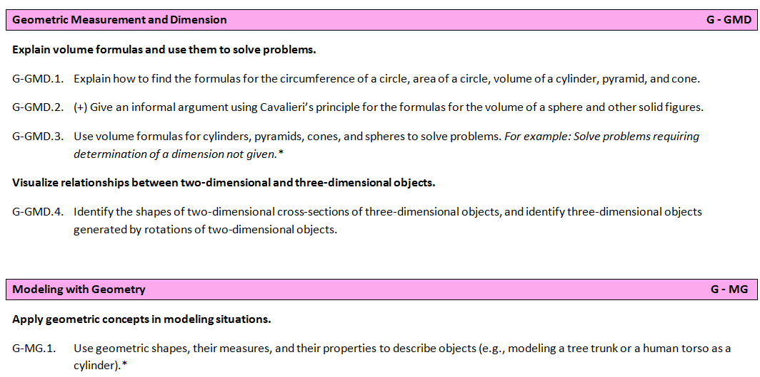
Closer Look at Standards (9-12)
Conceptual Category - Geometry
Domains
Notes:
Let’s take a look at a sample standards in grade span 9-12.
The domain is Geometry (G) - in this example can only tell by the coding.
There are two domains in the shaded boxes - Geometric Measurement and Dimension and Modeling with Geometry. There are two clusters in bold shown for Geometric Measurement – Explain volume formulas and Visualize relationships . . and one for Modeling with Geometry – Apply geometric concepts . . .
Let’s look at G-GMD.2 Give an informal argument . . . – the + symbol indicates this is an additional standard for advance courses.
Looking at G-GMD.3 Use volume formulas for cylinders, . . . – the * indicates this standards provides an opportunity for modeling connections.
Notice that all the standards in the Modeling with Geometry indicate good connections (sometimes Modeling with Geometry would indicate the * instead).
Recommendation that you chose a high school domain. Notice the standards that are considered core, additional or for modeling.

Slide 34
Closer Look at Standards (9-12)
Geometry – Geometric Measurement and Dimension
Clusters
Notes:
In this same sample standards. Under the Geometric Measurement and Dimension – there are two clusters shown in bold.
Explain volume formulas and use them to solve problems and
Visualize relationships between two-dimensional and three-dimensional objects.

Slide 35
Closer Look at Standards (9-12)
Standards
Core
(+) Additional
Modeling (*)
Notes:
In this same snapshot of the standards, let’s look deeper at the standards themselves.
First G-GMD.1. Explain how to find . . . – this would indicate a core standard for all students
G-GMD.2 Give an informal argument . . . – the + symbol indicates this is an additional standard for advance courses.
G-GMD.3 Use volume formulas for cylinders, . . . – the * indicates this standards provides an opportunity for modeling connections.

Slide 36
Shift #3 Rigor – Modeling
Links classroom mathematics and statistics to everyday life, work and decision-making.
In Grades K-8, modeling skills are developed as one of the Standards for Mathematical Practice.
Modeling is both a High School Domain and a Standards for Mathematical Practice
Domains, Strands, Clusters or Individual Standards have been identified by *
Notes:
Modeling provides opportunities for both rigor and relevance. Rigor through application of the mathematics in the real world. Relevance through using problems and task that are community based incorporating the cultural standards.

Slide 37
Standards for Mathematical Practice
Both a goal and a vehicle -
The goal is to move students along a continuum – always deepening their use of the mathematical practices.
They are a vehicle for learning the content standards.
37
Notes:
The Standards for Mathematical Practice provide another approach the shift in Rigor.
The Standards for Mathematical Practice are both a goal and a vehicle.
The goal is to move students along a continuum – always deepening their use of the mathematical practices.
They are a vehicle for learning the content standards.

Slide 38
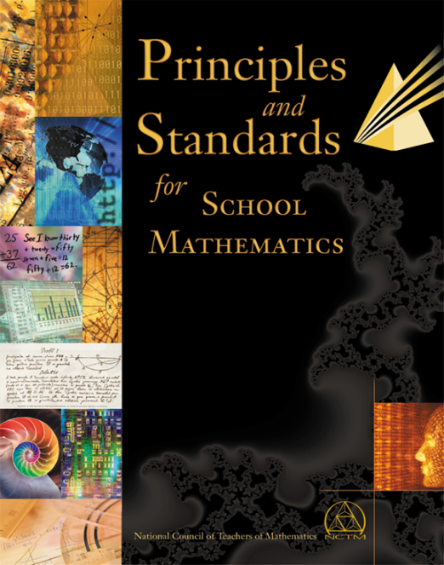
Background Information
National Council of Teachers of Mathematics Principal and Standards (2000)
Problem Solving
Reasoning and Proof
Connections
Communication
Representation
38
Notes:
The Standards for Mathematical Practice are based on ‘processes and proficiencies’ with longstanding importance in mathematics education research.
The first of these are the National Council of Teachers of Mathematics (NCTM) standards. The NCTM Standards were a foundation of the Alaska GLE math process skills.

Slide 39
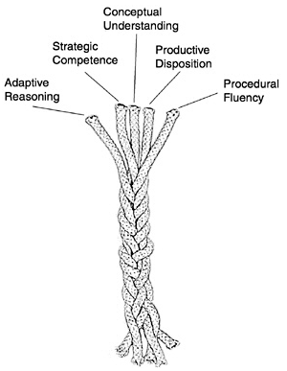
Background Information
The National Research Council’s Report Adding It Up (2001)
39
Notes:
The Standards for Mathematical Practice are based on ‘processes and proficiencies’ with longstanding importance in mathematics education research.
The second are the interwoven strands outlined by the National Research Council’s Report. Adding It Up. Students show proficiency in mathematics as the result of five strands: Adaptive Reasoning, Strategic Competence, Conceptual Understanding, Productive Disposition, and Procedural Fluency. Working definitions for these proficiency strands can be found on page 4.

Slide 40
Strands of Mathematical Proficiency
Conceptual Understanding – comprehension of mathematical concepts, operations, and relations
Procedural Fluency – skill in carrying out procedures flexibly, accurately, efficiently, and appropriately
Strategic Competence – ability to formulate, represent, and solve mathematical problems
Adaptive Reasoning – capacity for logical thought, reflection, explanation, and justification
Productive Disposition – habitual inclination to see mathematics as sensible, useful, and worthwhile, coupled with a belief in diligence and one’s own efficacy.
Notes:
Facilitators won’t need to read this slide aloud, but suggest that participants do so if they are not familiar with the Strands of Mathematical Proficiency.
Consider doing turn and talk—how are these different from NCTM process Standards.
e.g., strategic competence includes formulating, representing and solving problems.
Be sure to draw attention to productive disposition—since that is different than what is explicitly in NCTM Process Standards and is very important for practices.
Many educators are continuing to use both the Strands of Mathematical Proficiency and the NCTM Process Standards with the Standards for Mathematical Practice since each adds depth and dimension to our understanding of mathematical fluency.

Slide 41
Standards for Mathematical Practice
Make sense of problems and persevere in solving them
Reason abstractly and quantitatively
Construct viable arguments and critique the reasoning of others
Model with mathematics
Use appropriate tools strategically
Attend to precision
Look for and make use of structure
Look for and express regularity in repeated reasoning
41
Notes:
The Standards for Mathematical Practice describe characteristics and traits that mathematics educators at all levels should seek to develop in their students. They describe ways that students should be engaging with mathematics as they progress through school. The integration of these standards into classroom instruction is a key strategy for increasing cognitive demand and conceptual learning.
Please take a moment to read the 8 Standards for Mathematical Practice.

Slide 42
Mathematical Practice Descriptions
Read the paragraph description for Practice #5.
Notice the verbs used to describe actions students will take.
42
Notes:
For each Standard for Mathematical Practice there is a paragraph description of explanation. Let’s look in more detail at Mathematical Practice #5 – Use appropriate tools strategically. As you review this description, notice the verbs used to describe actions students will take.

Slide 43
Grade-Span Proficiency Descriptors
5. Use appropriate tools strategically
Read the proficiency descriptors for TWO grade spans.
Notice the continuum of development.
43
Notes:
Unique in Alaska’s standards, grade‐span proficiency descriptors are provided for each Standard of Mathematical Practice. These are meant to help students, parents and educators to picture how these practices might be demonstrated by students.
Please choose TWO grade spans to compare the proficiency descriptors.

Slide 44
Mathematical Practice Task
In October, John’s PFD check for $1100 arrives. His parents give him 2 choices so the rest can be saved for post-secondary options.
Choice 1: Spend 1/5 of the PFD
Choice 2: Spent 15% of the PFD
Which would give him the most spending money? Justify your answer
44
Notes:
One way the Standards for Mathematical Practice can be connected to the Standards for Mathematical Content is through the use of mathematical tasks. Tasks require students to apply the mathematical practices to allow a deep understanding and application of math. Let’s take a look at this sample task made relevant to Alaska.
Hopefully, you were tempted to solve the task and noticed the math content knowledge needed. The math content involved would be fractions and percent.

Slide 45
Standards for Mathematical Practice
Graphic
A
B
C
45
Notes:
William McCallum, one of the authors of the national standards, has proposed grouping the related mathematical practice standards as outlined. The two standards on the left are considered to be involved in all mathematic tasks and problems. Remember many tasks may involve a number of practices depending on the students approach.
Using these grouping, which mathematic practices were used in the sample task?
In this task, the student likely used Reasoning and Explaining to be able to justify their answer.

Slide 46
Thank You
Your time is much appreciated!
Questions about the math standards
Deborah Riddle, Math Content Specialist
deborah.riddle@alaska.gov

